Slide 1
University Network System

Slide 2
Contents and Project Description
Router Setup
Access Point Setup
PC Setup
Wireless Settings
Server Setup(HTTP,DNS)
Introduction:
First we have taken a router(model 1841), then we have taken 2 switches(model 2950-24) which are connected to the router . One switch is connected to the servers and another one is connected to all 5 access point by a wire(coper straight).And all the access point has some PC’S connected with them by wireless connection . We need know about access point and server.
Server: In computing, a server is a piece of computer hardware or software that provides functionality for other programs or devices, called "clients".

Slide 3
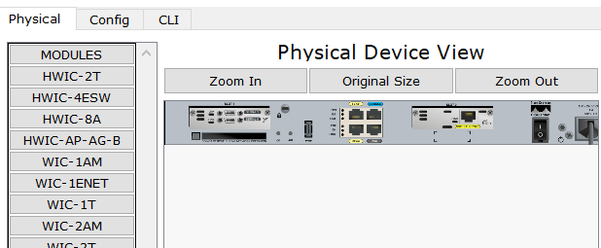
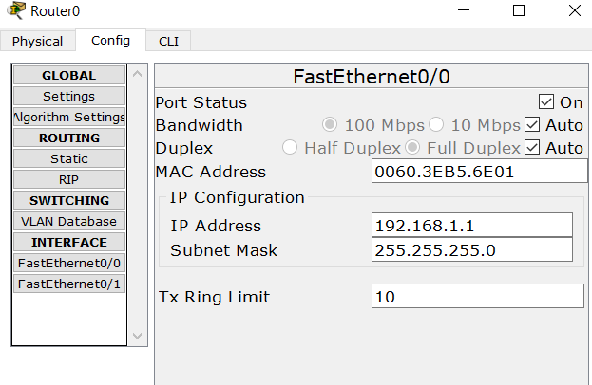
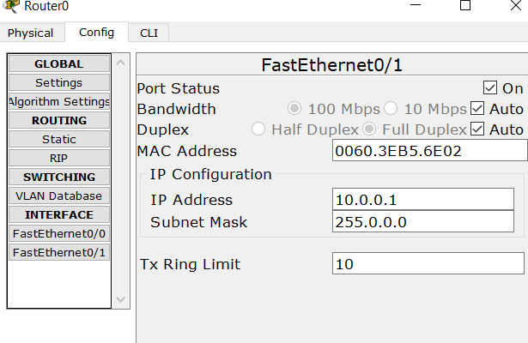
Router Setup
So for the router setup first we go to the router option which is called physical . Then we turned off the router and taken two port named WIC-2T and WIC-1ENT and added to the router . Then we turned on the router.
In the 2nd step we open the config option and entered FastEthernet0/0 .Here we put IP address 192.168.1.1 and subnet 255.255.255.0.Lastly we turned on FastEthernet0/0 port . This port is connected to the access point switch.
In the 3rd step we open the FastEthernet0/1 and put the IP address 10.0.0.1 and subnet 255.0.0.0.Then we turned on the FastEthernet1/0 This port is connected to the server Switch.

Slide 4
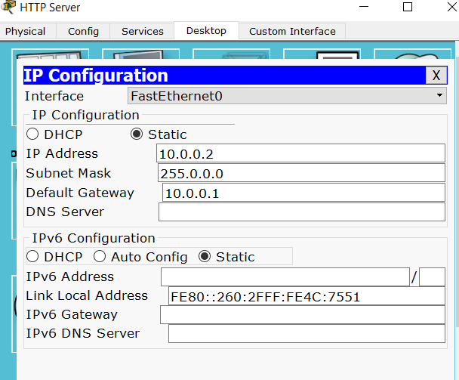
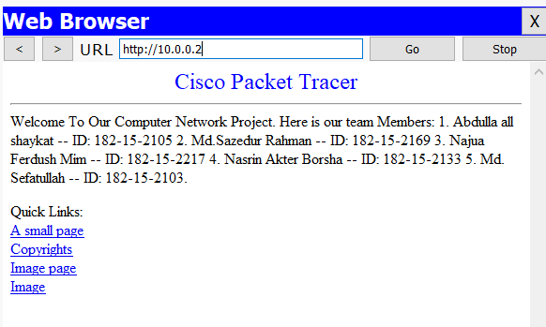
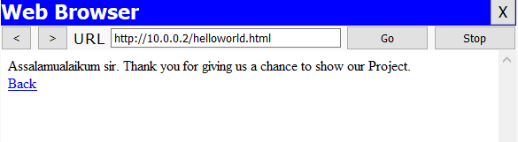
HTTP Server Setup
We have taken two generic server called HTTP server and another one is DNS server . These two server is connected with a switch1 by wire . Then we open HTTP server and entered desktop option . Then selected IP configuration and select static and entered IP address 10.0.0.2 and subnet mask 255.0.0.0 and Default gateway 10.0.0.1 which is the router FastEthernet0/1 IP address.
Then go to the services option and entered HTTP option and turned it on . After that we entered DHCP,TFTP,DNS and turned those off.

Slide 5
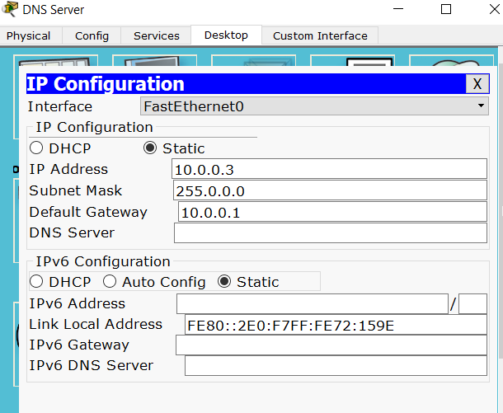
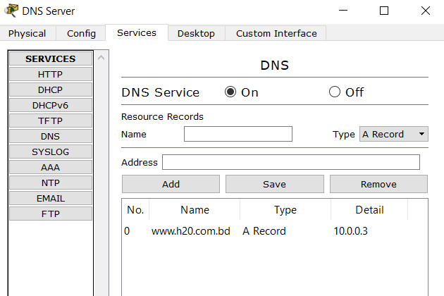
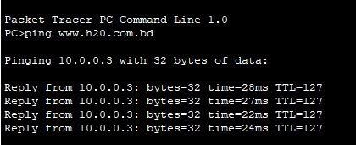
DNS Server Setup
Then we open DNS server and entered desktop option . Then selected IP configuration and select static and entered IP address 10.0.0.3 and subnet mask 255.0.0.0 and Default gateway 10.0.0.1 which is the router FastEthernet0/1 IP address.
Then go to the services option and entered DNS option and turned it on . Now we put a domain name and a ip address which are www.h20.com.bd and 10.0.0.3 .After that we entered DHCP,TFTP,HTTP and turned those off.

Slide 6
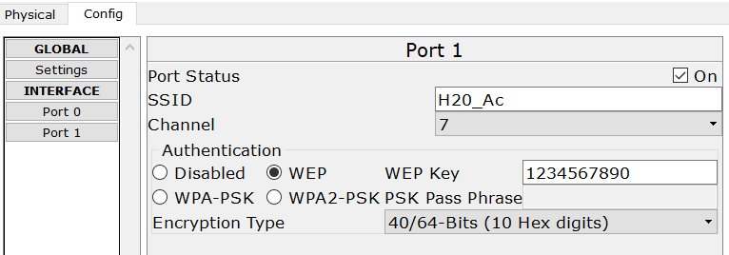
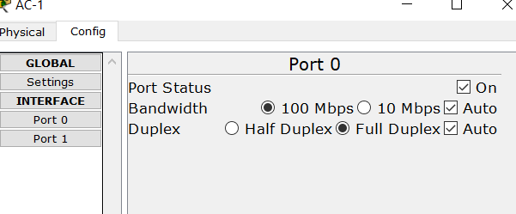
Access Point Setup
Access point:
In computer networking, a wireless access point, or more generally just access point, is a networking hardware device that allows other Wi-Fi devices to connect to a wired network.
Then for the Access Point-PT or AC-1 we go to the config option . After that we entered port 0 and selected auto for bandwidth and duplex and turned it on . Lastly we entered port 1 we give name for SSID and then give WEP authentication and a passcode for the network . Without the passcode no pc can access the network.

Slide 7
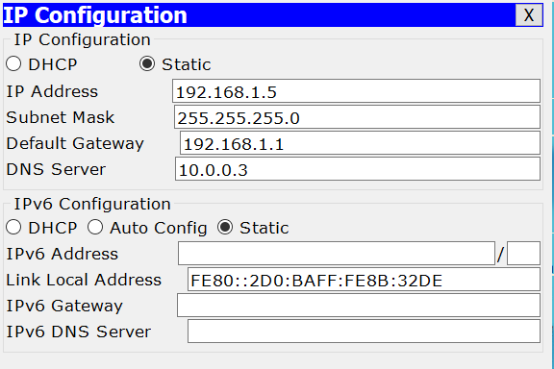
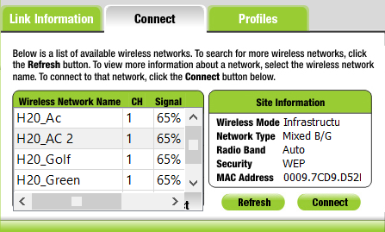
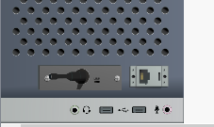
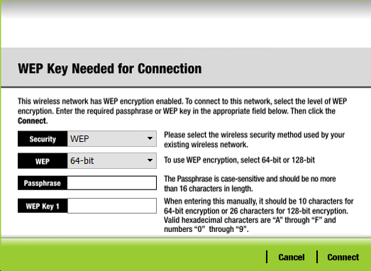
PC-01 Setup
Then we open PC-1 and entered desktop option . Then selected IP configuration and select static and entered IP address 192.168.1.5,subnet mask 255.255.255.0,Default gateway 192.168.1.1 and DNS server 10.0.0.3.Next we need to configure wireless connection . So now we have to go to the physical option and turned off the pc . After that we added wireless port WMP300N and turned on the pc . Then we entered desktop>pc wireless>connect . Here we will see our desired access point which one we want to connect . Then select it and give the passcode for connection.

Slide 8
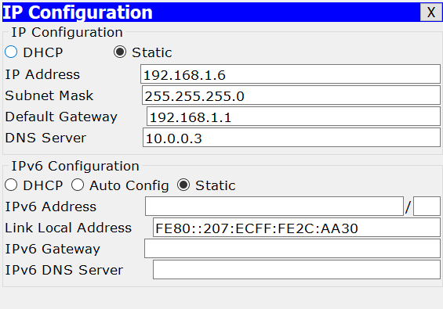
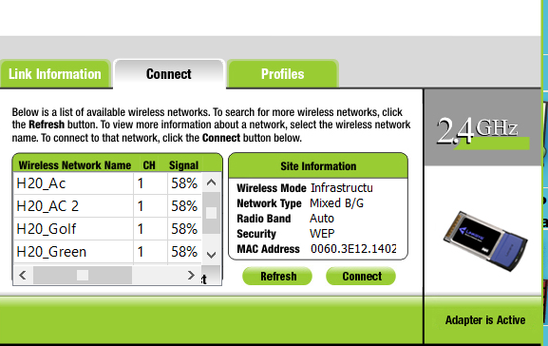
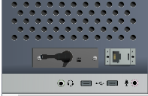
PC-02 Setup
Then we open PC-2 and entered desktop option . Then selected IP configuration and select static and entered IP address 192.168.1.6,subnet mask 255.255.255.0,Default gateway 192.168.1.1 and DNS server 10.0.0.3.Next we need to configure wireless connection . So now we have to go to the physical option and turned off the pc . After that we added wireless port WMP300N and turned on the pc . Then we entered desktop>pc wireless>connect . Here we will see our desired access point which one we want to connect . Then select it and give the passcode for connection.

Slide 9
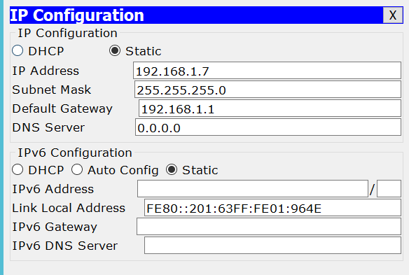
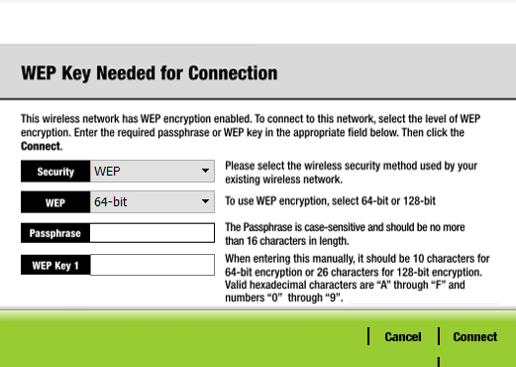
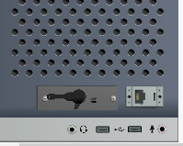
PC-03 Setup
Then we open PC-3 and entered desktop option . Then selected IP configuration and select static and entered IP address 192.168.1.7,subnet mask 255.255.255.0,Default gateway 192.168.1.1 and DNS server 10.0.0.3.Next we need to configure wireless connection . So now we have to go to the physical option and turned off the pc . After that we added wireless port WMP300N and turned on the pc . Then we entered desktop>pc wireless>connect . Here we will see our desired access point which one we want to connect . Then select it and give the passcode for connection.

Slide 10
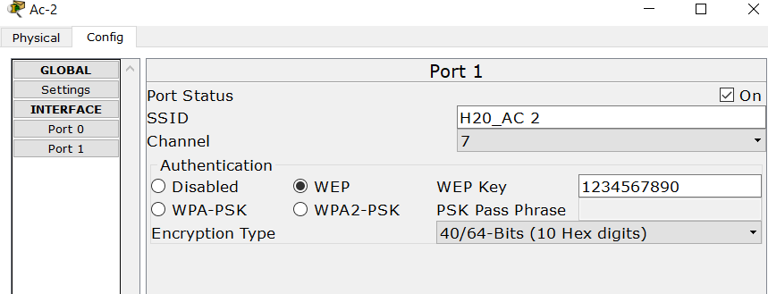
Access Point PT or AC-02 Setup
Then for the Access Point-PT or AC-2 we go to the config option . After that we entered port 0 and selected auto for bandwidth and duplex and turned it on . Lastly we entered port 1 we give name for SSID and then give WEP authentication and a passcode for the network . Without the passcode no pc can access the network.

Slide 11
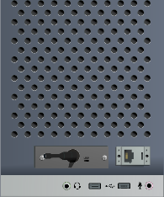
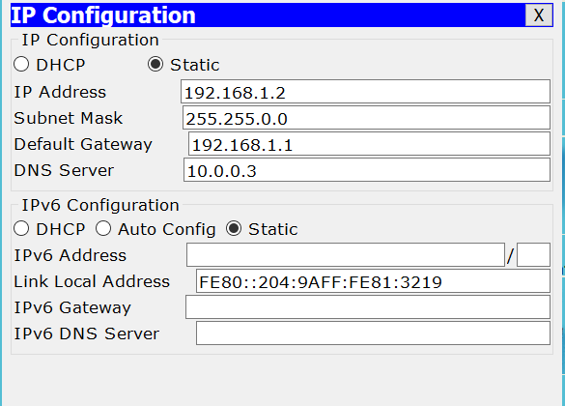
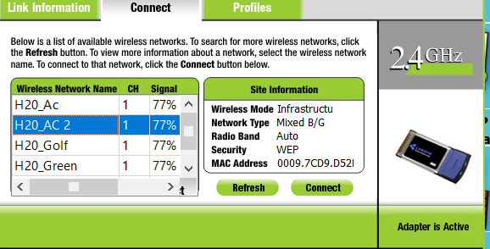
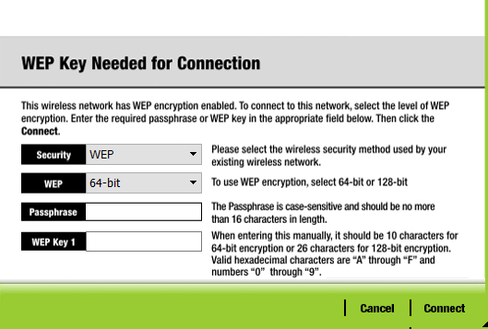
PC-04 Setup
Then we open PC-4 and entered desktop option . Then selected IP configuration and select static and entered IP address 192.168.1.2,subnet mask 255.255.255.0,Default gateway 192.168.1.1 and DNS server 10.0.0.3.Next we need to configure wireless connection . So now we have to go to the physical option and turned off the pc . After that we added wireless port WMP300N and turned on the pc . Then we entered desktop>pc wireless>connect . Here we will see our desired access point which one we want to connect . Then select it and give the passcode for connection.

Slide 12
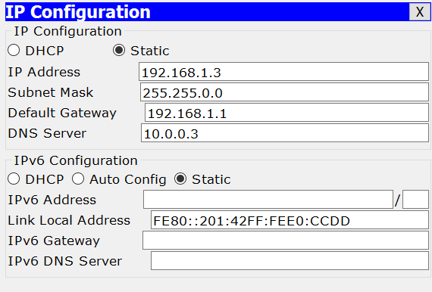
PC-05 Setup
Then we open PC-5 and entered desktop option . Then selected IP configuration and select static and entered IP address 192.168.1.3,subnet mask 255.255.255.0,Default gateway 192.168.1.1 and DNS server 10.0.0.3.Next we need to configure wireless connection . So now we have to go to the physical option and turned off the pc . After that we added wireless port WMP300N and turned on the pc . Then we entered desktop>pc wireless>connect . Here we will see our desired access point which one we want to connect . Then select it and give the passcode for connection.

Slide 13
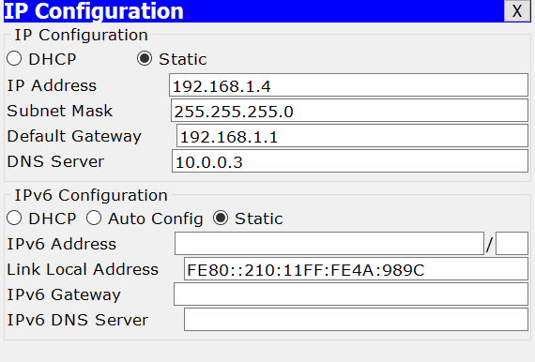
PC-06 Setup
Then we open PC-6 and entered desktop option . Then selected IP configuration and select static and entered IP address 192.168.1.4,subnet mask 255.255.255.0,Default gateway 192.168.1.1 and DNS server 10.0.0.3.Next we need to configure wireless connection . So now we have to go to the physical option and turned off the pc . After that we added wireless port WMP300N and turned on the pc . Then we entered desktop>pc wireless>connect . Here we will see our desired access point which one we want to connect . Then select it and give the passcode for connection.

Slide 14
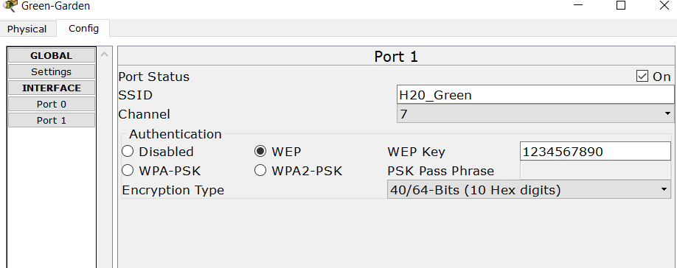
Access Point PT or Green Garden Setup
Then for the Access Point-PT or Green_Garden we go to the config option . After that we entered port 0 and selected auto for bandwidth and duplex and turned it on . Lastly we entered port 1 we give name for SSID and then give WEP authentication and a passcode for the network . Without the passcode no pc can access the network.

Slide 15
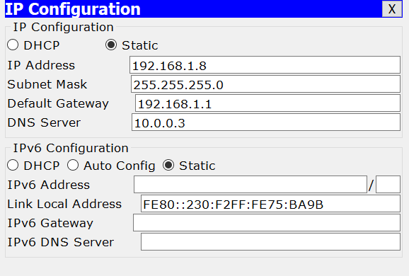
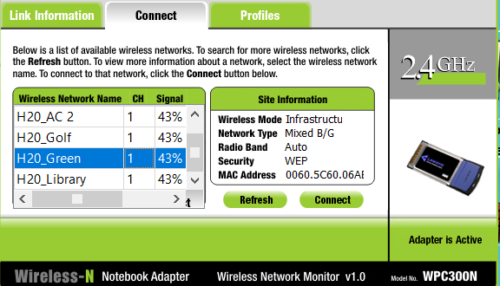
PC-07 Setup
Then we open PC-7 and entered desktop option . Then selected IP configuration and select static and entered IP address 192.168.1.8,subnet mask 255.255.255.0,Default gateway 192.168.1.1 and DNS server 10.0.0.3.Next we need to configure wireless connection . So now we have to go to the physical option and turned off the pc . After that we added wireless port WMP300N and turned on the pc . Then we entered desktop>pc wireless>connect . Here we will see our desired access point which one we want to connect . Then select it and give the passcode for connection.

Slide 16
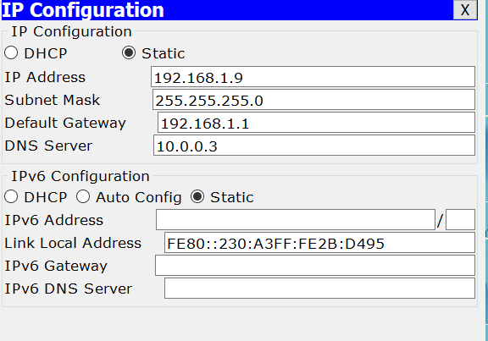
PC-08 Setup
Then we open PC-9 and entered desktop option . Then selected IP configuration and select static and entered IP address 192.168.1.9,subnet mask 255.255.255.0,Default gateway 192.168.1.1 and DNS server 10.0.0.3.Next we need to configure wireless connection . So now we have to go to the physical option and turned off the pc . After that we added wireless port WMP300N and turned on the pc . Then we entered desktop>pc wireless>connect . Here we will see our desired access point which one we want to connect . Then select it and give the passcode for connection.

Slide 17
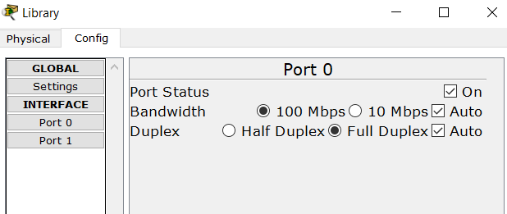
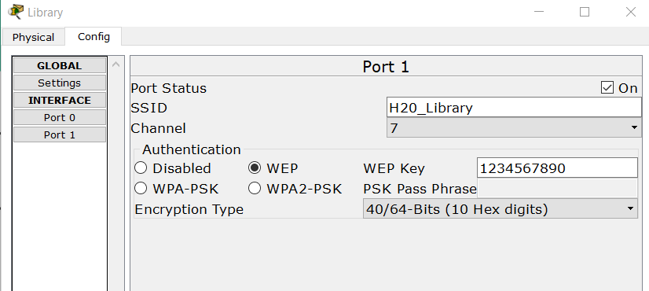
Access Point PT or Library
Then for the Access Point-PT or Library we go to the config option . After that we entered port 0 and selected auto for bandwidth and duplex and turned it on . Lastly we entered port 1 we give name for SSID and then give WEP authentication and a passcode for the network . Without the passcode no pc can access the network.

Slide 18
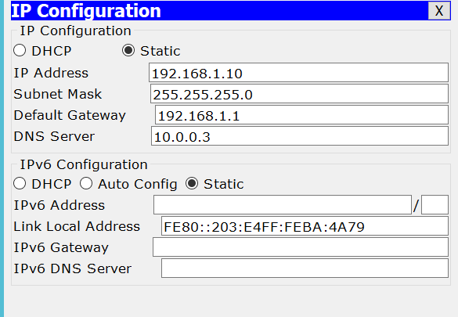
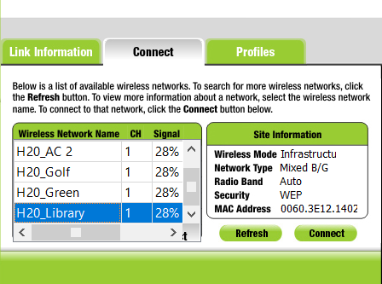
PC-09 Setup
Then we open PC-9 and entered desktop option . Then selected IP configuration and select static and entered IP address 192.168.1.10,subnet mask 255.255.255.0,Default gateway 192.168.1.1 and DNS server 10.0.0.3.Next we need to configure wireless connection . So now we have to go to the physical option and turned off the pc. After that we added wireless port WMP300N and turned on the pc . Then we entered desktop>pc wireless>connect . Here we will see our desired access point which one we want to connect . Then select it and give the passcode for connection.

Slide 19
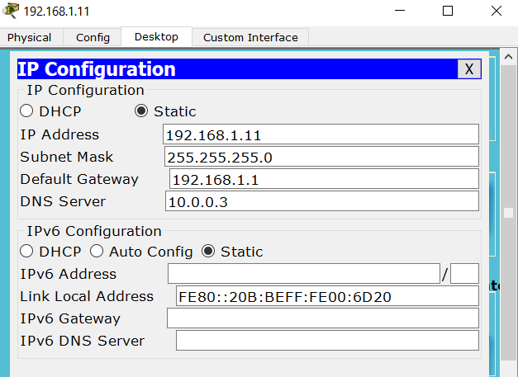
PC-10 Setup
Then we open PC-10 and entered desktop option . Then selected IP configuration and select static and entered IP address 192.168.1.11,subnet mask 255.255.255.0,Default gateway 192.168.1.1 and DNS server 10.0.0.3.Next we need to configure wireless connection . So now we have to go to the physical option and turned off the pc . After that we added wireless port WMP300N and turned on the pc . Then we entered desktop>pc wireless>connect . Here we will see our desired access point which one we want to connect . Then select it and give the passcode for connection.

Slide 20
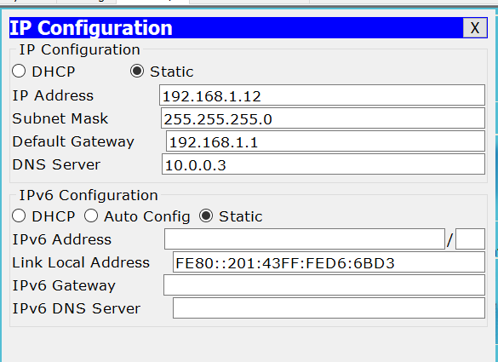
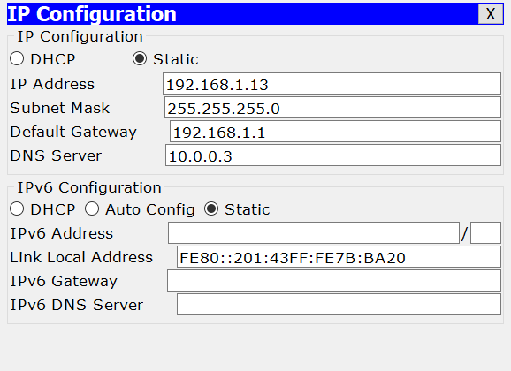
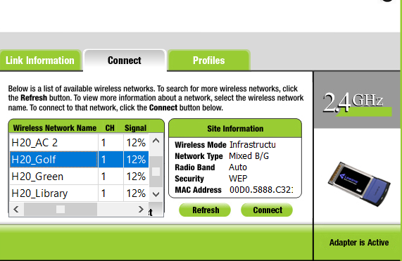
Access Point or Golf Field and PC Setup

Slide 21
Sending Packets
Then we will sent a packet from a server to a pc to see is our project working perfectly or not . After that we will sent another packet from a pc to another pc in simulation mode . Then we will sent packet in real time mode to see is the project is working fine or not.
Then we will check our HTTP server working or not by going to the PC configuration and go to the web browser ,then enter 10.0.0.2 to check HTTP server.
Lastly we will check our DNS server working or not by going to the pc configuration>desktop>command prompt and write ping (domain name)

Slide 22
Thank you

